Slide 1
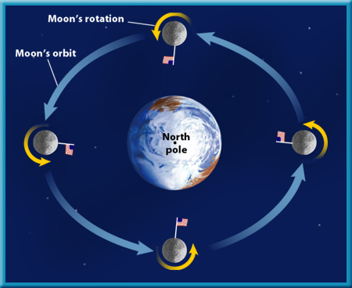
INTRODUCTION
It takes 29.5 days for the Moon to revolve around the Earth and we always see that same side of the moon. (we never see the back side)

Slide 2
Why do we have MOON PHASES?
Different amounts of sunlight light up the moon and, from Earth, makes the moon appear to have “different shapes” or phases.

Slide 3
Waxing vs. Waning
Waxing- light is being “added” and the moon is looking bigger each day.
Waning- the light is going away and the moon appears to be “shrinking” each day.

Slide 4
NEW MOON
The side of the moon that is lit up is facing the sun and the dark side is facing the Earth. We do not see a moon.

Slide 5
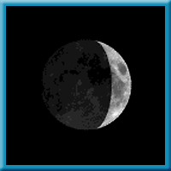
WAXING CRESCENT
During this phase, the right side of the moon is illuminated and resembles a smile.

Slide 6
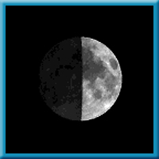
1ST QUARTER
The entire right-half of the moon is illuminated and the moon continues to “grow”.

Slide 7
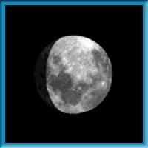
WAXING GIBBOUS
Now the moon is more than half-full, but not fully lit up. It is still getting bigger.

Slide 8
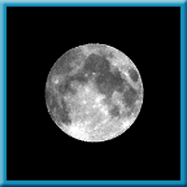
FULL MOON
The entire side of the moon facing Earth is lit up and appears like a complete circle.

Slide 9
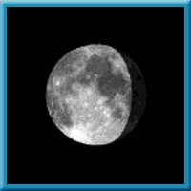
WANING GIBBOUS
After being full, now the moon is “shrinking in size”. It is more than half-way lit, but now the right side appears dark.

Slide 10
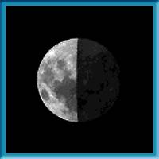
3RD QUARTER
During this phase, the entire left-half of the moon is illuminated and the entire right-half is dark. We’re getting closer to a new moon.

Slide 11
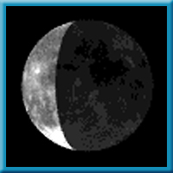
WANING CRESCENT
Opposite a waxing crescent, the left side of the moon is illuminated and resembles a smile.

Slide 12
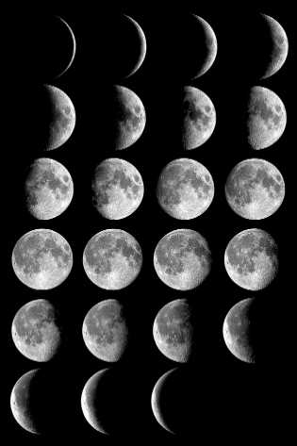
The cycle continues with a new moon…..

